Slide 1
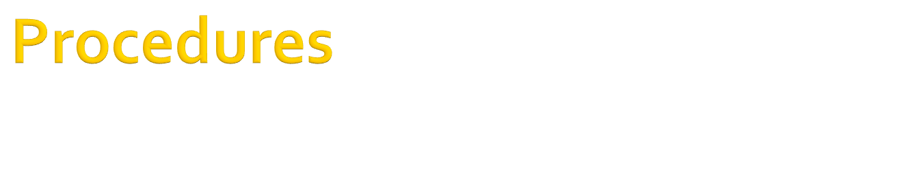

Slide 2

An application is made up of small, self-contained segments called procedures.
Procedures can be used for implementing repeated tasks, such as frequently used calculations.
Visual Basic has several types of procedures, summarized here:
  Event procedures are used to respond when a specific event occurs.
  Property procedures are used to create class properties
  Sub and Function procedures are used by the developer to organize and simplify source code.
The difference between subroutines and functions is that functions return a value, while subroutines don’t.

Slide 3

A subroutine is a block of statements that carries out a well-defined task.
The block of statements is placed within a set of Sub…End Sub statements and can be invoked by name as shown below:
Sub SubName([argument_list])
‘body of procedure
End Sub
Here
  SubName is the name of the procedure
  argument_list is an optional list of arguments – information that is passed to the procedure when it is called. It is of the form
  <keyword> arg_name As Datatype
  Keyword can be ByVal or ByRef

Slide 4
The statements in a subroutine are executed when it is called
When the End Sub statement is reached, control returns to the calling program.
It is possible to exit a subroutine prematurely, with the Exit Sub statement.
Example
Sub prime(ByVal n As Integer)
If n=0 Then
Exit Sub End If
End Sub

Slide 5

Sub OddEven(ByVal n As Integer)
n = TextBox1.text
If n MOD 2 = 0 Then MsgBox(“Number Is Even”)
Else
MsgBox(“Number Is Odd”)
End If
End Sub

Slide 6
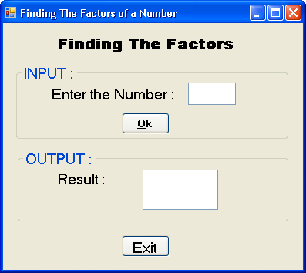
Private Sub btnOk_Click(.. …) Handles btnOk.Click
varNum = txtNum.Text
REM Calling the Subroutine
factors(varNum)
End Sub
Sub factors(ByVal varnum As Integer)
Dim varI As Integer
lstResult.Enabled = True
varI = 1
If IsNumeric(varnum) Then
Do While varI <= varnum
If varnum Mod varI = 0 Then
lstResult.Items.Add(varI)
End If
varI = varI + 1
Loop
Else
MsgBox("Please enter a numeric integer value")
txtNum.Text = ""
txtNum.Focus()
End If
End Sub
Subroutines: Example

Slide 7
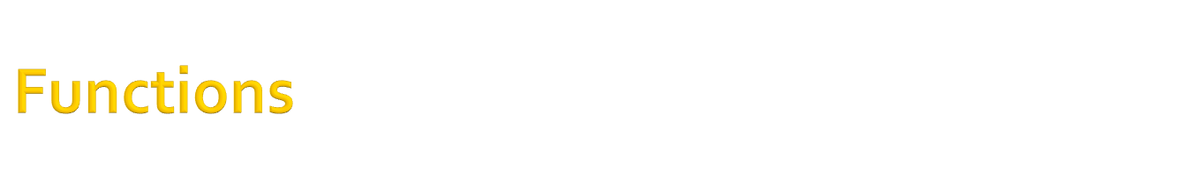
A function is similar to a subroutine, but a function returns a result.
However, both functions and subroutines can accept arguments.
The value we pass back to the calling program from a function is called the return value, and its type must match the type of the function.
Function FuncName(argument_list) As DataType
… …
… …
Return (variable_name)
End Function
The statements that make up a function are placed in a set of Function…End Function statements.

Slide 8
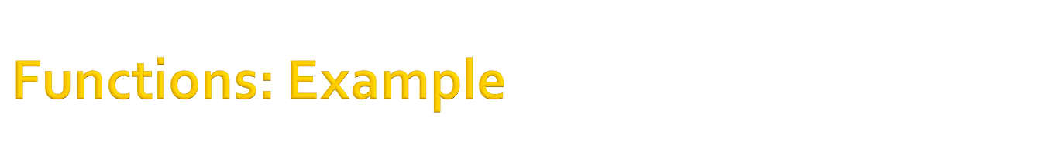
Function IsEven(ByVal n As number) As Boolean
Dim res As Boolean
If n mod 2 = 0 Then res=true
Else
res=false
End If
Return(res)
End Function

Slide 9

When a program calls a procedure, it must pass a value for each of the procedure’s arguments. For example,
Call Prime(123)
To specify that an argument is an array, we use an empty set of parentheses following the name.
Sub Arr(ByVal A( ) As Integer)
… …
End Sub
When we call a procedure, we must pass the right number and type of arguments or an error will occur.
The only exception is when the procedure is defined to take optional arguments.

Slide 10

A Function procedure is called differently than a Sub procedure.
Because a function returns a value, it can be treated like an expression and used anywhere an expression would be used.
For example,
Sum = Add(80, 101)
Result = Add(10, 50) / Add(-5, 33)

Slide 11

The .NET framework provides a large number of functions that implement common or complicated tasks.
There are functions for the common math operations, functions to perform calculation with dates, financial functions, and many more.
When we use such built-in functions, we don’t have to know how they work internally.
The Pmt( ) function, for example, calculates the monthly payment on a loan.

Slide 12

Procedures can accept more than one argument.
Function Min(ByVal a As Single, ByVal b As Single) As Single
result= IIF(a<b, a, b)
End Function
IIF( ) is a built-in function that evaluates the first argument. If it is True, the function returns second argument and if it is False, the IIF( ) function returns the third argument.

Slide 13
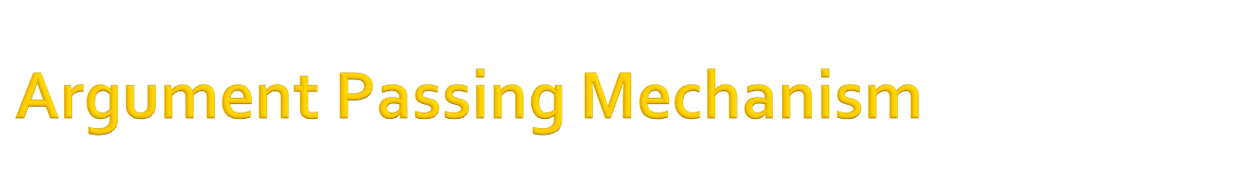
Passing Argument By Value
When an argument is passed by value, the procedure sees only a copy of the argument.
Even if the procedure changes it, the changes aren’t permanent.
To specify the arguments, the ByVal keyword (default option) is used in front of the argument’s name.
Passing Argument By Reference
When an argument is passed by reference, it gives the access to the actual values.
The calling procedure passes the address of the variable in memory so that the procedure can change its value permanently.
To specify the arguments, the ByRef keyword is used in front of the argument’s name.

Slide 14
Argument Passing Mechanism
Sub Swap(ByVal A As Single, ByVal B As Single)
Dim Temp As Single
Temp = A
A = B
B = Temp
MsgBox(“A = ” & A & “B = ” & B)
End Sub
Now suppose the procedure is called as follows:
A = 5
B = 10
Call Swap(A, B)
MsgBox(“A = ” & A & “B = ” & B)
Within the procedure, the variable A will become 10 and variable B will be 5. However, after execution returns from the procedure, the variable A will have the value 5 and B 10.

Slide 15
Argument Passing Mechanism
Sub Swap(ByRef A As Single, ByRef B As Single)
Dim Temp As Single
Temp = A
A = B
B = Temp
MsgBox(“A = ” & A & “B = ” & B)
End Sub
Now suppose the procedure is called as follows:
A = 5
B = 10
Call Swap(A, B)
MsgBox(“A = ” & A & “B = ” & B)
Within the procedure, the variable A will become 10 and variable B will be 5. Also, after execution returns from the procedure, the variable A will have the value 10 and B will be 5. Hence, in this case, the change in value is permanent.

Slide 16
Passing Argument By Value (Finding The Factors)
Private Sub btnOk_Click(… …) Handles btnOk.Click
Dim varNum As Integer
varNum = txtNum.Text
  factors(varNum) REM Calling the Subroutine
  End Sub
Sub factors(ByVal varnum As Integer)
Dim varI As Integer
… …
… …
Do While varI <= varnum
If varnum Mod varI = 0 Then
lstResult.Items.Add(varI)
End If
varI = varI + 1
Loop
Else
MsgBox("Please enter a numeric integer value")
txtNum.Text = ""
txtNum.Focus()
End If
End Sub

Slide 17
Assignments
Using a procedure, WAP to calculate the simple interest [SI = (Principal x Rate x Time) / 100].
Using a function, WAP to find the norm of a matrix. The norm of a matrix is defined as the square root of the sum of all the squares of all the elements in the matrix. Design your interface tastefully.

Slide 18

Recursive programming is used for implementing algorithms, or mathematical definitions, that are described recursively, that is, in terms of themselves.
A recursive definition is implemented by a procedure that calls itself; thus, it is called a recursive procedure.
A recursive function must exit explicitly. In other words, we must tell a recursive function when to stop calling itself and exit.

Slide 19

A Simple Example: Finding The Factorial Of A Number
Function Factorial (n As Integer) As Double
If n = 1 Then
Return 1
Else
Return n * Factorial(n-1)
End If
End Function

Slide 20

By default, VB matches the values passed to a procedure to the declared arguments by their order. That is why the arguments are called as positional arguments.
However, we can also use the concept of named arguments to remove the limitation of positional arguments.
Example:
Function divide(ByVal numerator As Integer, ByVal deno
As Integer) As Single
Return (numerator/deno)
End Function

Slide 21

The := operator assigns values to the named arguments.
Using named arguments, we can call the function divide in this manner:
divide(deno:=4, numerator:=12)
Since the arguments are passed by name, we can supply them in any order.

Slide 22

A function can return only one value
Thus, to return multiple values, we can either pass
  An array or
  A certain number of arguments by reference

Slide 23

Functions are not limited to returning simple data types like integers or strings.
They may return complex data types such as structures and arrays.
Example:
      Function GetData( ) As Customer
      ‘statements
      End Function
In the above case, Customer is a structure which is a custom data type.

Slide 24

There are situations where the same function must operate on different data types, or a different number of arguments.
VB.NET introduces the concept of function overloading where we can have multiple implementations of the same function, each with a different set of arguments and, possibly, a different return value.
Assignment: Using three procedures by the same name ‘Sum’, WAP to perform three different tasks:
Calculate the sum of two integer values
Calculate the sum of three decimal values
Join two strings separated by a space

Slide 25

When we pass objects as arguments, they are passed as reference, even if we have specified the ByVal keyword.
The procedure can access and modify the members of the object passed as argument, and the new value will be visible in the procedure that made the call.

Slide 26

A variation of the For Loop
Syntax:
For Each counter in list_of_items
‘statements
Next counter
This loop will iterate as long as there are elements in the list
The counter values are the values in the list. Thus in the first iteration, the counter value will be the first item in the list. Then second iteration, the counter value will be the first item in the list, and so on.
The counter should be the same data type as the values in the list

Slide 27

Sub Main()
Dim fruits() As String={“Apples”, ”Oranges”, ”Grapes”}
Dim counter As String
For Each counter in fruits
Console.WriteLine(counter)
Next counter
Console.ReadKey()
End Sub
OUTPUT
Apples
Oranges
Grapes

Slide 28
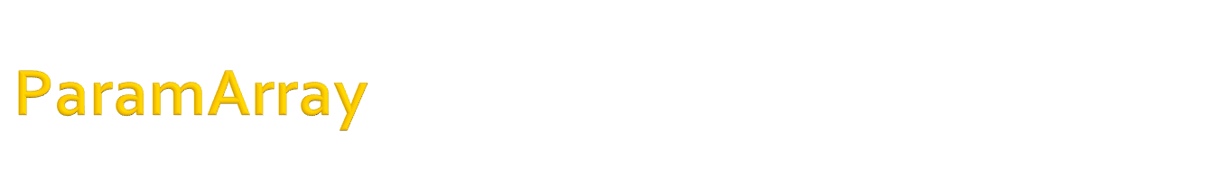
Passing an unknown number of arguments
Sometimes, it may happen that we do not know the number of arguments to be passed to the procedure.
For such cases, VB supports the ParamArray keyword, which allows one to pass a variable number of arguments to a procedure.
Example:
Sub List(ParamArray ByVal Names( ) As String)
Dim varX as String
For Each varX In Names
lstName.Items.Add(varX)
Next varX
End Sub
To add items to the list, we can call the Add procedure as follows: List(“Riya”, ”Piya”, “Diya”, Jiya”)

Slide 29

Event handlers never return a result, so they are implemented as subroutines.
In specific, we are going to examine the two arguments that are common to all event handlers – sender and e
The sender argument conveys information about the object that initiated the event
The e argument is an object that exposes some properties, which vary depending on the type of the event and the control that raised the event.

Slide 30
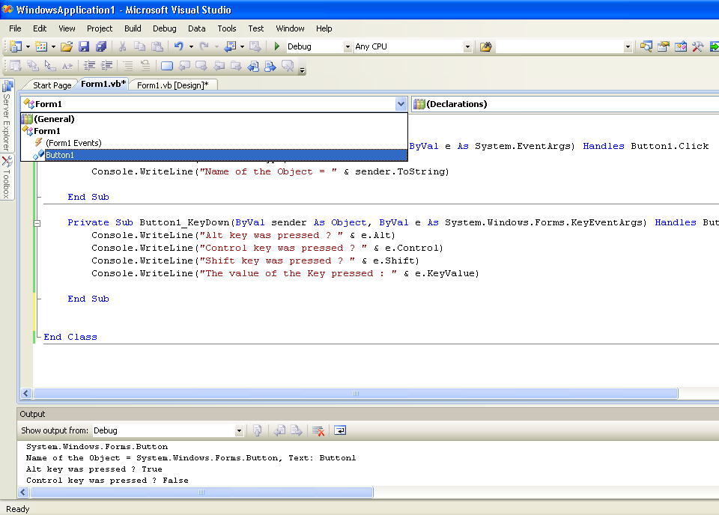

Slide 31
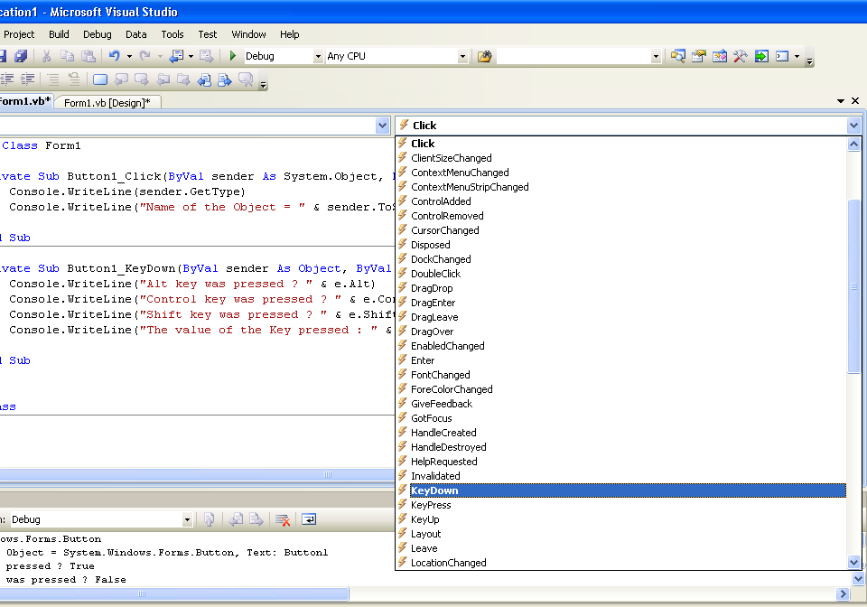

Slide 32
Public Class Form1
Private Sub Button1_Click(ByVal sender As System.Object, ByVal e As _System.EventArgs) Handles Button1.Click
Console.WriteLine(sender.GetType)
Console.WriteLine("Name of the Object = " & sender.ToString)
End Sub
End Class
System.Windows.Forms.Button
Name of the Object = System.Windows.Forms.Button, Text: Button1

Slide 33
Public Class Form1
Private Sub Button1_KeyDown(ByVal sender As Object, ByVal e As _ System.Windows.Forms.KeyEventArgs) Handles Button1.KeyDown
'Which key was pressed on the button and it value which is a unique
‘number
Console.WriteLine("Alt key was pressed ? " & e.Alt)
Console.WriteLine("Control key was pressed ? " & e.Control)
Console.WriteLine("Shift key was pressed ? " & e.Shift)
Console.WriteLine("The value of the Key pressed : " & e.KeyValue)
End Sub
End Class
Alt key was pressed ? True
Control key was pressed ? False
Shift key was pressed ? False
The value of the Key pressed : 18

Slide 34
Public Class Form1
Private Sub Button1_MouseDown(ByVal sender As Object, ByVal e As _ System.Windows.Forms.MouseEventArgs) Handles Button1.MouseDown
Console.WriteLine("Button Pressed At : " & e.X & ", " & e.Y)
Console.WriteLine(“Value of the Mouse Button Pressed = " &
e.Button)
Console.WriteLine("Number of Click(s) = " & e.Clicks)
End Sub
End Class
Button Pressed At : 18, 14
Value of the Mouse Button Pressed = 1048576
Number of Click(s) = 2

